Slide 1

MedCoach
Interim Presentation
Mai Werthaim & Maya Kimhi

Slide 2

Project Description
Case Preparation
Input: Diseases and their symptoms
Output: Patient cases and their diagnosis
Task: Text generation
Medical students are often overwhelmed by theoretical study and lack practical diagnostic experience.
MedCoach offers an AI-driven learning environment with realistic, interactive case simulations that advance medical decision-making with immediate, relevant feedback
Student Examination
Input: Partial patient case
Output: Student diagnosis and questions
Task: Question-Answering
Feedback Generation
Input: Doctor questions and diagnosis, Student questions and diagnosis,
Output: Student evaluation (avg questions to diagnosis & similarity between doctor & student)
Task: Text similarity
Dataset: Diseases and their Symptoms
Labels: Prognosis

Slide 3
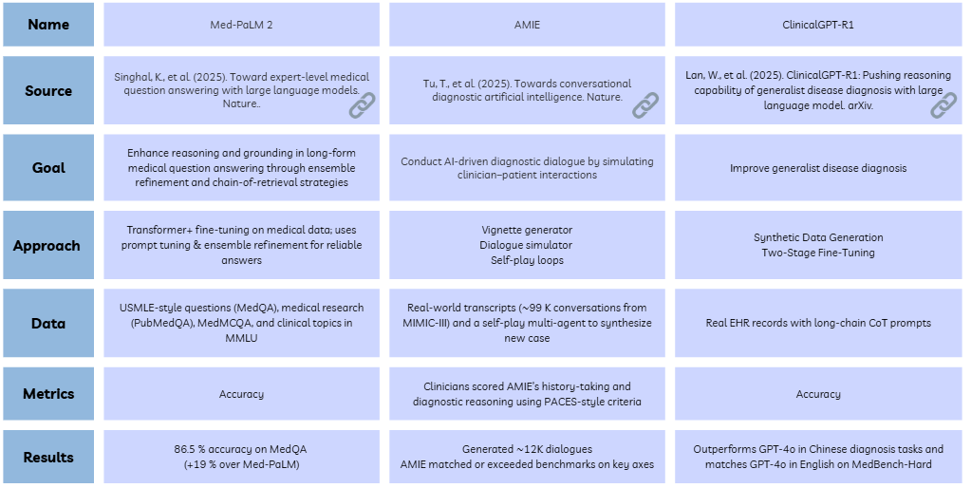

Prior Art

Slide 4

NLP Pipeline
Case Preparation
Benchmark Generation
Student Stimulation
Evaluation
Input: Raw Data:
100 random sample of Symptoms and diagnoses.
Output: Table of 4 columns - Diagnosis, full patient case, 80% case, 50% case.
Task: Patient Case Creation
Model: MedLlama2
Metric: Model-based evaluation (PubMedBERT)
Input: A table of 4 columns - Diagnosis, full patient case, 80% case, 50% case.
Output: K pairs of columns (doctor's question, doctor's diagnosis)
Task: Doctor & patient role playing.
Model: Me-LLaMA 13B as doctor & MedLlama2 as patient
Metric: Accuracy, AUC
Input: Full patient case,
80% patient case,
50% patient case.
Output: K pairs of columns (student question and diagnosis)
Task: Student & patient role playing.
Model: DeepSeek-R1 as sudent & MedLlama2 as patient
Metric: Accuracy, AUC
Input: Doctors question &
diadnosis, student question & diagnosis
Output: Similarity between doctor questions & student questions
Task: Comparing student to doctor
Model: None (NLP Metrics)
Metric: average questions to diagnosis, questions cosine similarity.

Slide 5
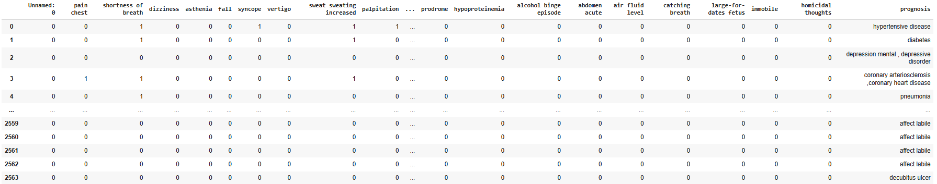
Data exploration
Raw data - Diseases and their Symptoms
2564 rows
400 symptoms
133 unique diseases
13 duplicate rows

Slide 6
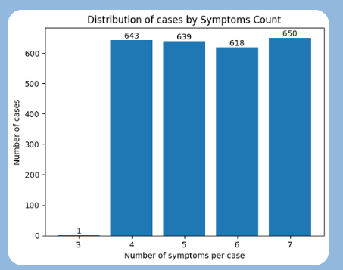
Data exploration
Raw data statistics:
Average rows per disease: 19.18
Disease with most rows: bipolar disorder (43 rows)
Disease with fewest rows: decubitus ulcer (3 rows)
Each disease have 3-7 symptomes
The most common symptom is pain (323 cases)
The least common symptom is dizzy spells (1 case)
Data Treating:
Duplicate deletion
Removal of symptoms not associated with any disease
Selection of cases with >=4 symptomes

Slide 7
Baseline
Random Sampling:
A random sample of 100 rows is selected from the original dataset.
Each row represents a real disease profile with associated symptoms.
Patient Case Generation:
For each selected disease instance, a synthetic patient case is generated using a language model (MedLlama2).
Each case includes:
Full Case: All symptoms associated with the disease.
80% Case: Approximately 80% of the symptoms.
50% Case: Approximately 50% of the symptoms.
Text-Based Diagnosis Modeling as doctor:
PubMedBERT is fine-tuned on the generated case descriptions to simulate a doctor's diagnosis.
Accuracy Comparison Across Case Levels:
Accuracy is measured for each level to assess how case completeness affects diagnosis quality.

Slide 8
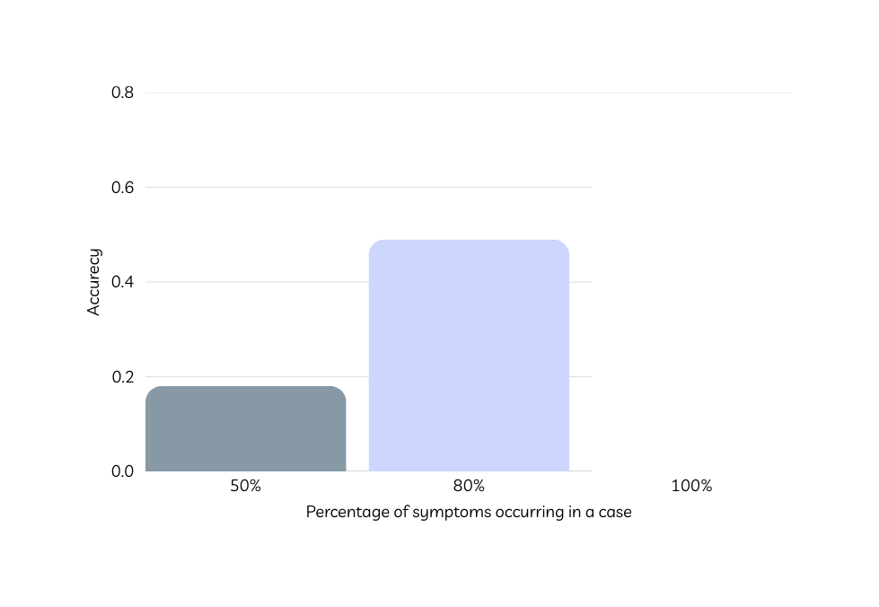
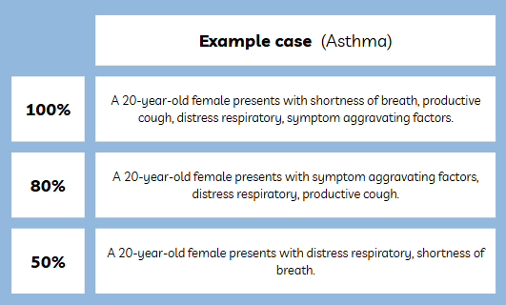
Baseline
0.79
0.49
0.18
As expected, the accuracy of the diagnosis increases as the percentage of available data in the case rises.

Slide 9

Insights
The data source is rich enough to provide good patient cases for diagnosis
There is a relationship between the amount of exposure and accuracy.
Recommendations
Assessment whether dataset size can be reduced.
Zero-shot diagnosis for further evaluate the robustness of the generated cases.

